Slide 1

British Airways
Web Scrapping and Predict Audience Behavior
Submitted By:
Bhumi Mehta

Slide 2

Agenda
Task 1: Web Scraping Customer Reviews
Task 2: Predictive Modeling of Customer Bookings
Conclusion

Slide 3
Task 1: Web Scraping Customer Reviews

Slide 4
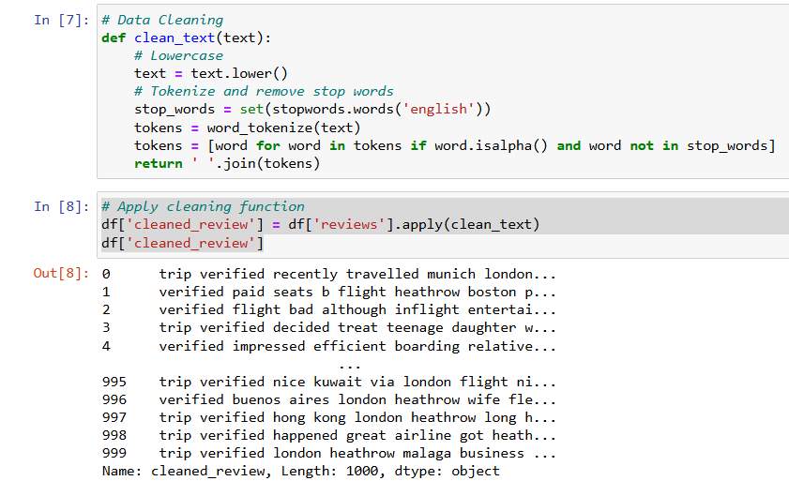
1.Data Scrapping:
Extracted several pages of Skytrax reviews using BeautifulSoup scrapping method. The collected data was then stored in a list and organized into a panadas dataframe for further analysis.
2. Data Cleaning:
Converted all text to lowercase for uniformity.
Removed common stop words like ‘the’, ’and’ .
Filtered out non-alphabetic tokens
Created new column ‘cleaned_review’ of this processed text.

Slide 5
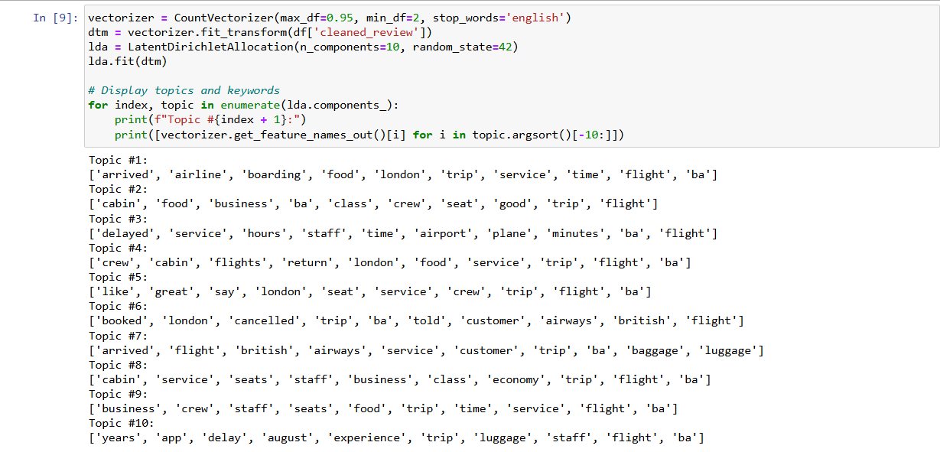
Topic Modelling Using LDA
Service Efficiency & Travel Logistics: A lot of reviews indicates dissatisfaction with reservations, cancellations, and luggage handling, as well as problems with arrival times, boarding procedures, and delays. Cabin Experience Matters: The cabin experience is extremely valued, particularly in business class, where crew service, comfortable seating, and high-quality cuisine are important aspects of passenger happiness. Crew Performance & App Feedback: While feedback on the airline's app identifies areas that require work for better trip management, consistent appreciation for crew performance demonstrates strengths in service.

Slide 6
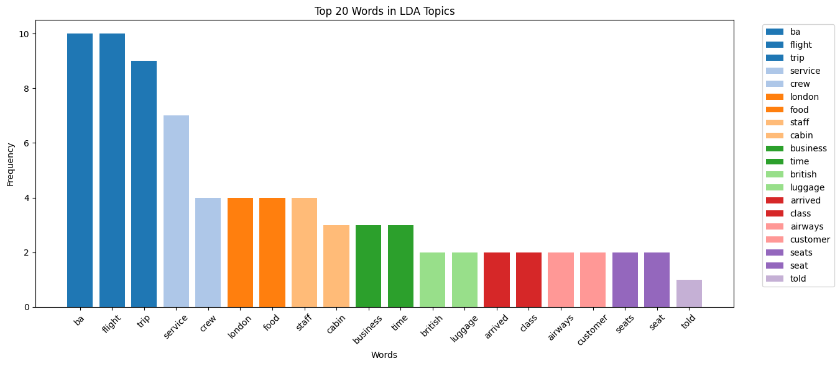
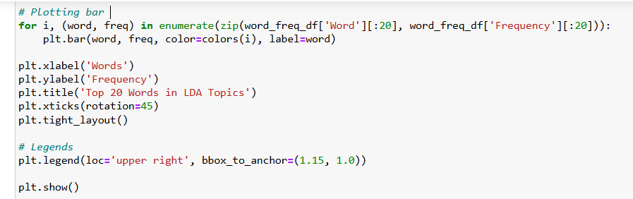
Visualization
The words "ba" and "flight," both appear 10 times each, are the most common in the LDA topics. This shows that the dataset's main topics are these words.
Words like "service," "crew," and "staff" indicates a major focus on staff and customer service, which is essential to defining user experience.
The words "London" and "british" indicate a regional or geographic emphasis in the subjects, most likely related to British Airways.

Slide 7
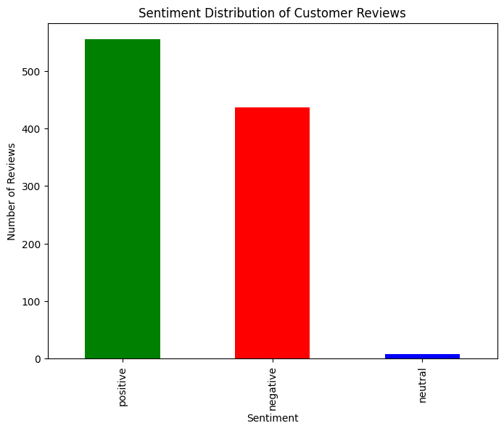
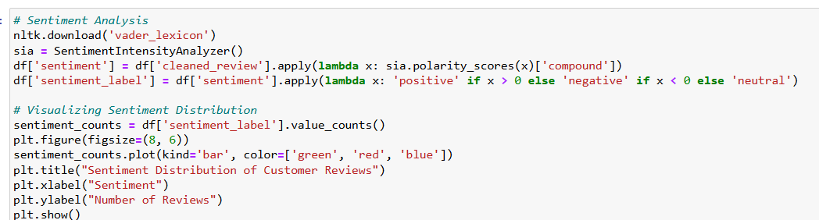
Sentiment Analysis
Positive Reviews: It's evident that the majority of customers have had a good experience, as there are about 520 reviews that are positive.
Negative Reviews: About 420 reviews are negative, indicating there are substantial areas for improvement.
Neutral Reviews: Only over 10% of evaluations are neutral, indicating that consumers tend have strong opinions, whether they be positive or negative.

Slide 8
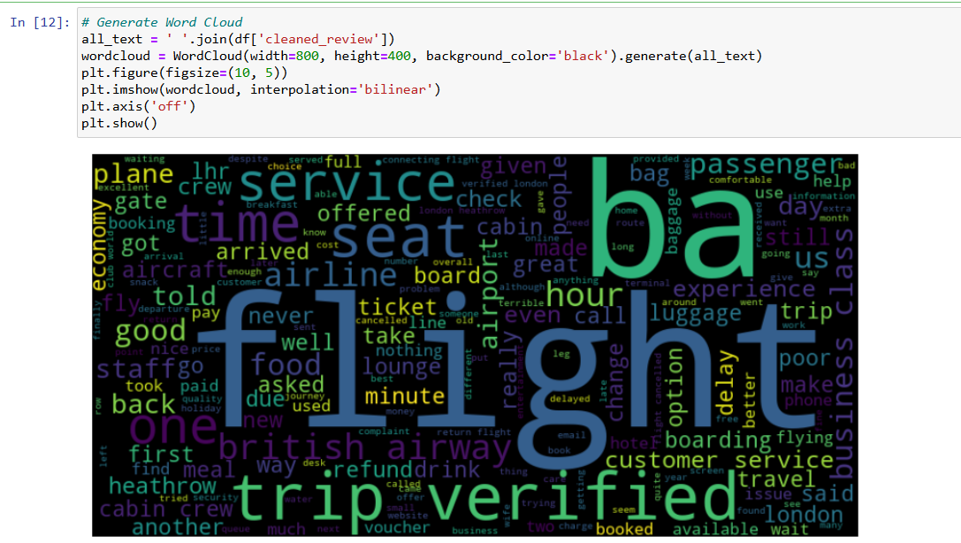
Word Cloud

Slide 9
Task 2: Predicting Customer Booking Behavior

Slide 10
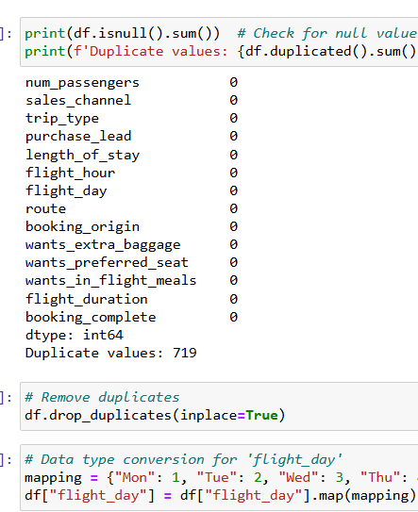
EDA
Data Cleaning:
Checked for null values.
Identified 719 duplicate values and deleted them for accurate analysis.
Converted ‘flight_day’ datatype to integer.

Slide 11
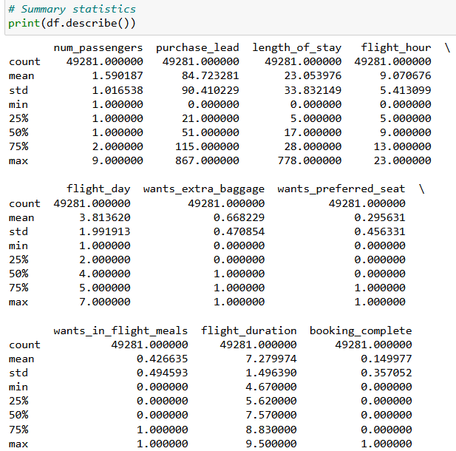
2. Summary Statistics:
The average booking includes around 1.59 passengers, with most involving 1-2 passengers and a maximum of 9, indicating some group travels.
The mean lead time is about 84.73 days, showing wide variation as some customers book well in advance while others book closer to the travel date.
The average stay is 23.05 days, but varies significantly, ranging from 0 to 778 days.
Most flights occur around 9 AM, with flight days evenly distributed across the week and a slight preference for mid-week.
67% of customers want extra baggage, 29.5% prefer seating, 42.6% want in-flight meals, and only about 15% of bookings are completed, indicating a high drop-off rate.

Slide 12
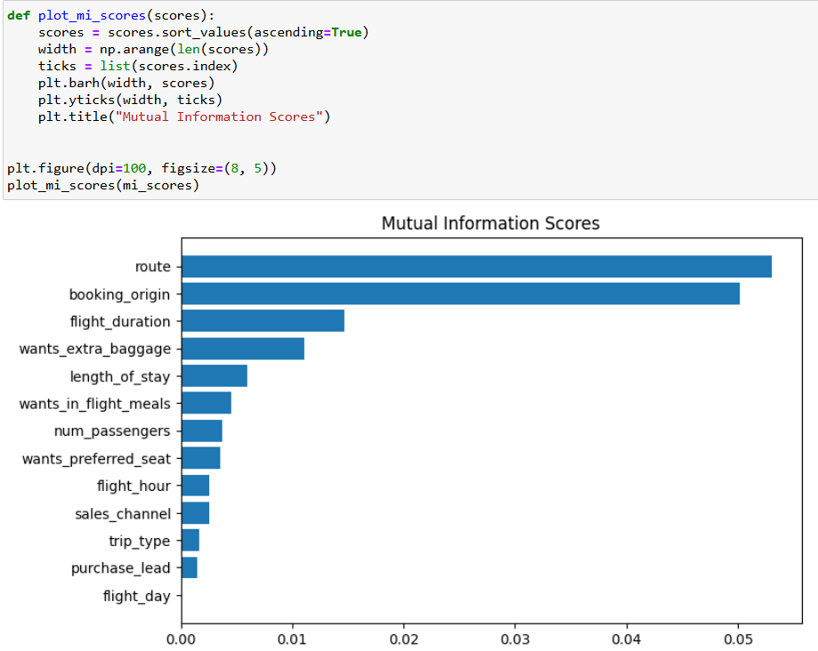
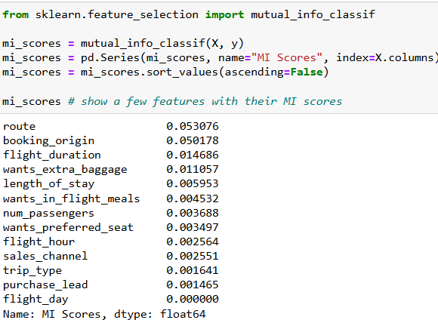
Top Features
From the above plot we can see that: route, booking_origin, flight_duration, wants_extra_baggage, length_of_stay are the top 5 features which are dependent with booking_complete feature.

Slide 13
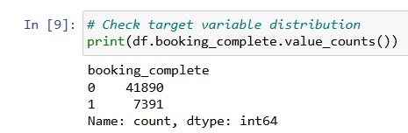
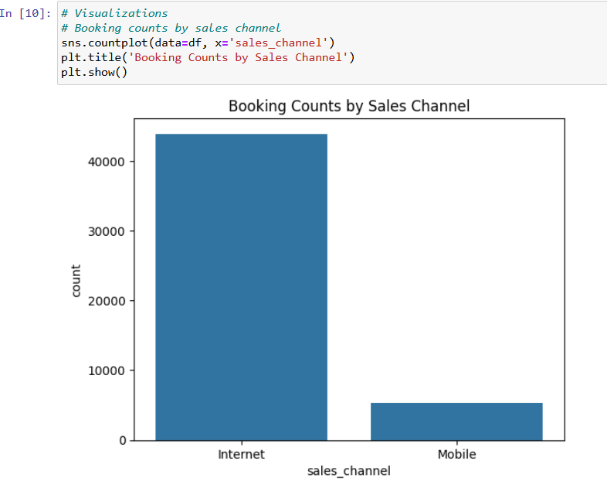
3. Distribution of Target Variable- ‘booking_complete’
4. Bookings by Sales Channel:
There are significantly more incomplete bookings (41,890) compared to completed bookings
(7,391), indicating a high dropoff rate in the
booking process.
According to the count plot, online bookings(above 40,000) contribute to the majority of bookings, drastically overtaking mobile bookings(around 10,000).

Slide 14
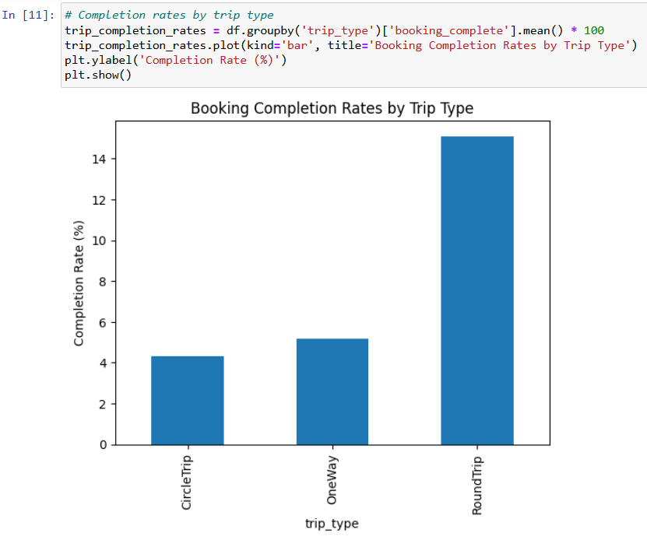
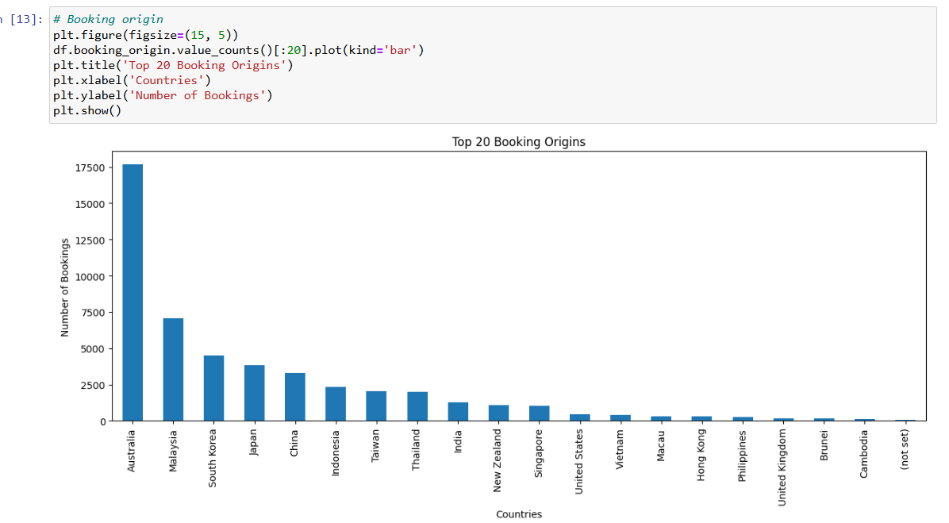
5. Completion Rates by Trip Type: 6. Top 20 Booking origins:
The ’Booking Completion Rates by Trip Type’ plot shows that RoundTrip bookings have the highest
completion rate at about 14%, followed by CircleTrip
at 6%, and OneWay at around 4%. This suggests that
customers are more likely to complete bookings for
round trips compared to other trip types.
Australia leads the top 20 booking origins, followed by a strong presence from countries like Malaysia, South Korea, Japan, and China.

Slide 15
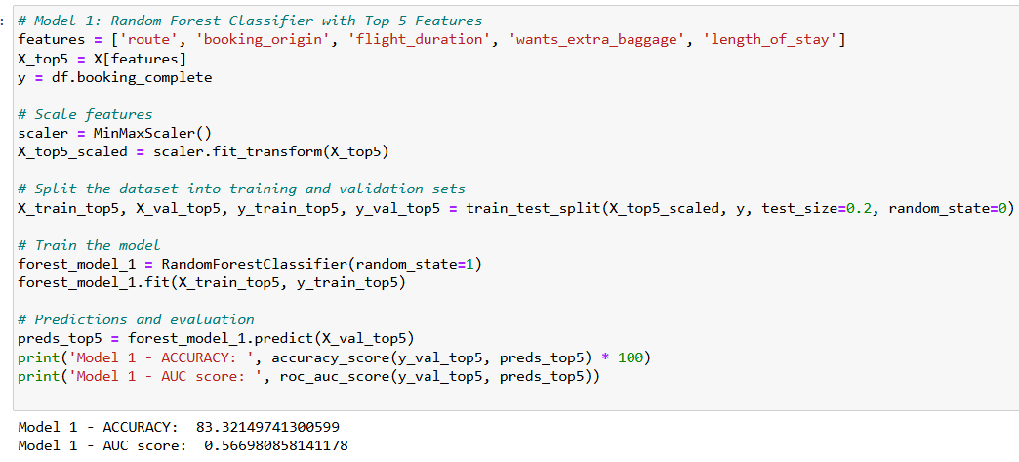
Model 1: Random Forest Classifier with Top 5 Features
The model achieved an accuracy of approximately 83.32%, indicating it correctly predicts booking
completion in most cases.
The AUC score is 0.57, suggesting the model's ability to differentiate between completed and not
completed bookings is moderate.

Slide 16
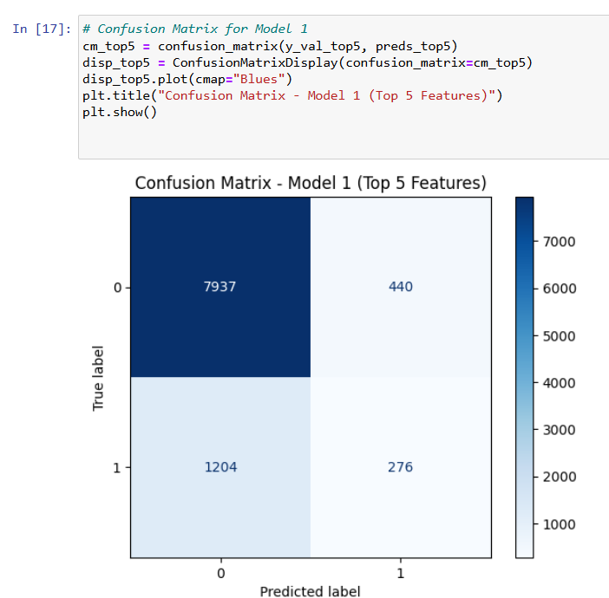
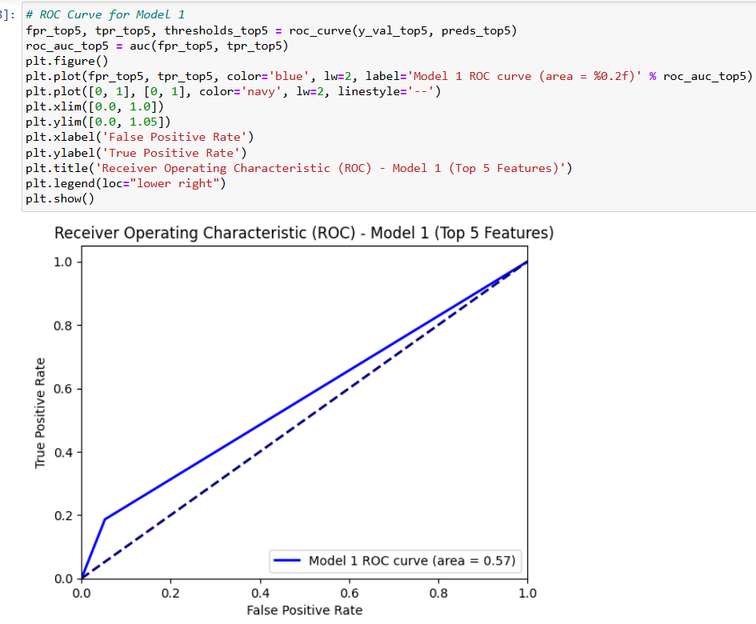
Confusion Matrix:
ROC Curve:
The confusion matrix shows the model correctly identified 7,937 incomplete bookings and 276 completed bookings, but also misclassified 1,204
completed bookings as incomplete and 440 incomplete bookings as completed, indicating it’s better at predicting incomplete bookings.
The ROC curve shows that the model has an AUC of 0.57, indicating that the model's ability to distinguish between completed and incomplete bookings is only slightly better than random guessing.

Slide 17
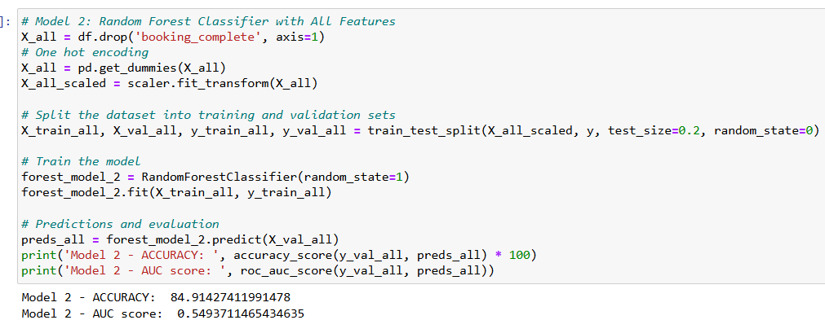
Model 2: Random Forest Classifier with All Features
It achieved an accuracy of approximately 84.91%, indicating a strong performance in predicting booking completion.
The AUC score is 0.55, suggesting that the model’s ability to distinguish between completed and incomplete bookings is moderate, slightly better than random guessing.

Slide 18
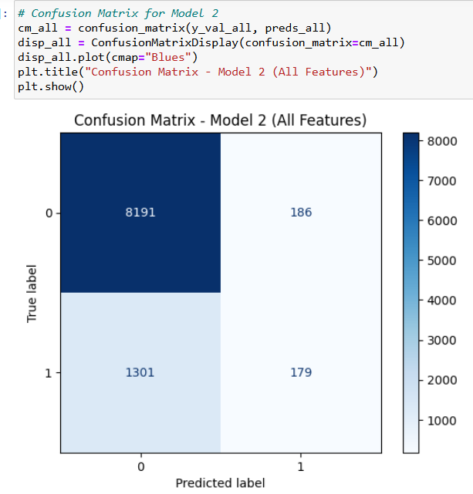
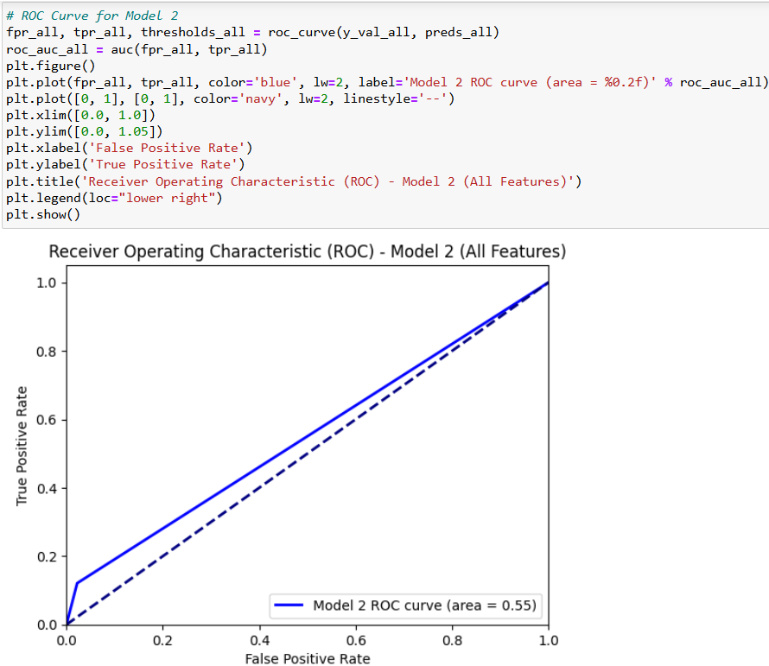
Confusion Matrix:
ROC Curve:
The confusion matrix shows the model accurately identified 8,191 incomplete bookings and 179 completed bookings, but misclassified 1,301
completed bookings as incomplete and 186 incomplete bookings as completed, indicating strong performance in predicting incomplete
bookings but weaker performance for completed ones.
The ROC curve for Model 2, with all features, shows an AUC of 0.55, indicating the model's ability to distinguish between completed and incomplete bookings is only slightly better than random guessing. The curve itself demonstrates a modest tradeoff between true positive rate and
false positive.

Slide 19
Conclusion
Model Performance: Both models show strong performance in predicting incomplete bookings but moderate in predicting completed ones.
Feature Impact: Including all features (Model 2) offers a slight accuracy improvement but doesn’t significantly enhance distinguishing capability (AUC score).
Focus Areas: Future improvements could focus on enhancing the model's ability to predict completed bookings and exploring other features or models.

Slide 20
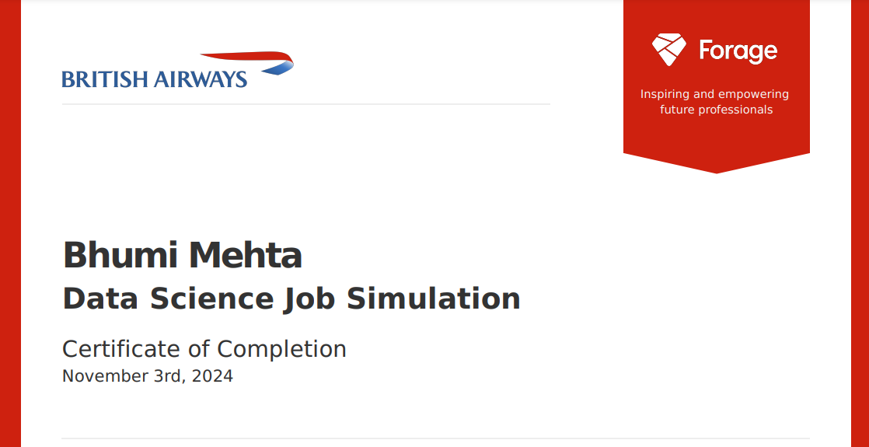

Slide 21

Thank You!!

